Slide 1
Dynamic Programming ---Pointers---

Slide 2
Objectives
In this chapter, you will:
Learn about the pointer data type and pointer variables
Explore how to declare and manipulate pointer variables
Learn about the address of operator and the dereferencing operator
Discover dynamic variables

Slide 3
Objectives (continued)
Explore how to use the new and delete operators to manipulate dynamic variables
Learn about pointer arithmetic
Discover dynamic arrays
Become aware of the shallow and deep copies of data

Slide 4
Pointer Data Type and Pointer Variables
Pointer variable: content is a memory address
There is no name associated with the pointer data type in C++

Slide 5
Declaring Pointer Variables
Syntax:
Examples:
int *p;
char *ch;
These statements are equivalent:
int *p;
int* p;
int * p;

Slide 6
Declaring Pointer Variables (continued)
In the statement:
int* p, q;
only p is the pointer variable, not q; here q is an int variable
To avoid confusion, attach the character * to the variable name:
int *p, q;
int *p, *q;

Slide 7
Address of Operator (&)
The ampersand, &, is called the address of operator
The address of operator is a unary operator that returns the address of its operand

Slide 8

Dereferencing Operator (*)
When used as a unary operator, * is the dereferencing operator or indirection operator
Refers to object to which its operand points
Example:
To print the value of x, using p:
To store a value in x, using p:

Slide 9
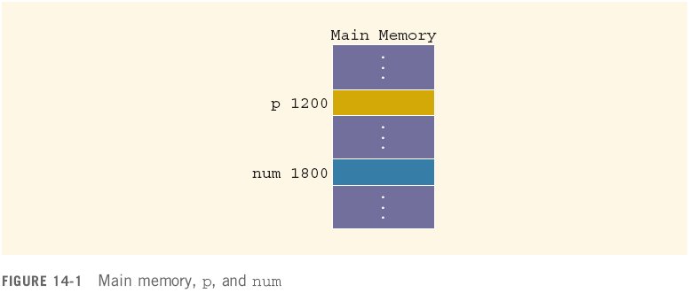

Slide 10


Slide 11
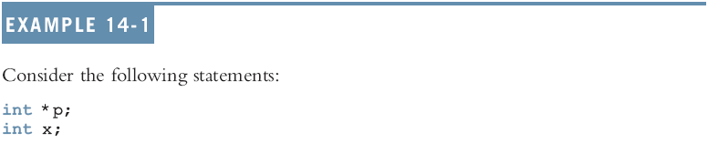
Allocates memory for p only, not for *p

Slide 12
http://codepad.org/A9s3mPu9

Slide 13
Structs and Pointer Variables
You can declare pointers to other data types:
student is an object of type studentType; studentPtr is a pointer variable of type studentType

Slide 14
Structs, and Pointer Variables (continued)
To store address of student in studentPtr:
studentPtr = &student;
To store 3.9 in component gpa of student:
(*studentPtr).gpa = 3.9;
() used because dot operator has higher precedence than dereferencing operator
Alternative: use member access operator arrow (->)

Slide 15
Structs, and Pointer Variables (continued)
Thus,
(*studentPtr).gpa = 3.9;
is equivalent to:
studentPtr->gpa = 3.9;
http://codepad.org/XbGLBWxU

Slide 16
Initializing Pointer Variables
C++ does not automatically initialize variables
Pointer variables must be initialized if you do not want them to point to anything
Initialized using the constant value 0
Called the null pointer
Example: p = 0;
Or, use NULL named constant: p = NULL;
The number 0 is the only number that can be directly assigned to a pointer variable

Slide 17
Dynamic Variables
Dynamic variables: created during execution
C++ creates dynamic variables using pointers
Two operators, new and delete, to create and destroy dynamic variables
new and delete are reserved words

Slide 18
Operator new
new has two forms:
where intExp is any expression evaluating to a positive integer
new allocates memory (a variable) of the designated type and returns a pointer to it
The address of the allocated memory
The allocated memory is uninitialized

Slide 19
Operator new (continued)
The statement: p = &x;
Stores address of x in p
However, no new memory is allocated
The statement: p = new int;
Creates a variable during program execution somewhere in memory, and stores the address of the allocated memory in p
To access allocated memory: *p

Slide 21
Operator new (continued)
new allocates memory space of a specific type and returns the (starting) address of the allocated memory space
If new is unable to allocate the required memory space, it throws bad_alloc exception
If this exception is not handled, it terminates the program with an error message

Slide 22
Operator delete

Slide 23
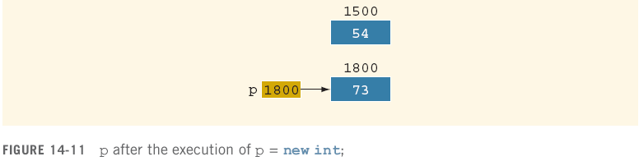
Operator delete (continued)
Memory leak

Slide 24
Operator delete (continued)
To avoid memory leak, when a dynamic variable is no longer needed, destroy it
Deallocate its memory
delete is used to destroy dynamic variables
Syntax:
Tip: to avoid dangling pointers, set variable to NULL afterwards

Slide 25
Operations on Pointer Variables
Assignment: value of one pointer variable can be assigned to another pointer of same type
Relational operations: two pointer variables of same type can be compared for equality, etc.
Some limited arithmetic operations:
Integer values can be added and subtracted from a pointer variable
Value of one pointer variable can be subtracted from another pointer variable

Slide 26
Operations on Pointer Variables (continued)
Examples:
int *p, *q;
p = q;
In this case, p == q will evaluate to true, and p != q will evaluate to false
int *p
double *q;
In this case, q++; increments value of q by 8, and p = p + 2; increments value of p by 16

Slide 27
Operations on Pointer Variables (continued)
Pointer arithmetic can be very dangerous
The program can accidentally access the memory locations of other variables and change their content without warning
Some systems might terminate the program with an appropriate error message
Always exercise extra care when doing pointer arithmetic

Slide 28
Dynamic Arrays
http://codepad.org/ZDYqrS2v
Dynamic array: array created during the execution of a program
Example:
int *p;
p = new int[10];
*p = 25;
p++; //to point to next array component
*p = 35;
stores 25 into the first memory location
stores 35 into the first memory location

Slide 29
Dynamic Arrays (continued)
C++ allows us to use array notation to access these memory locations
The statements:
p[0] = 25;
p[1] = 35;
store 25 and 35 into the first and second array components, respectively

Slide 30
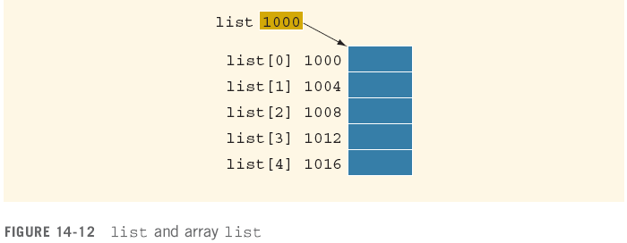


Slide 31
Dynamic Arrays (continued)
The value of list (1000) is constant
Cannot be altered during program execution
The increment and decrement operations cannot be applied to list
If p is a pointer variable of type int, then:
p = list;
copies the value of list, the base address of the array, into p
We can perform ++ and -- operations on p
An array name is a constant pointer

Slide 33
Functions and Pointers
A pointer variable can be passed as a parameter either by value or by reference
To make a pointer a reference parameter in a function heading, use &:
void example(int* &p, double *q)
{
. . .
}

Slide 34
Pointers and Function Return Values
A function can return a value of type pointer:
int* testExp(...)
{
. . .
}

Slide 35
Dynamic Two-Dimensional Arrays
You can create dynamic multidimensional arrays
Examples:
declares board to be an array of four pointers wherein each pointer is of type int
creates the rows of board
declares board to be a pointer to a pointer

Slide 36

Shallow versus Deep Copy and Pointers
Assume some data is stored in the array:
If we execute:

Slide 37
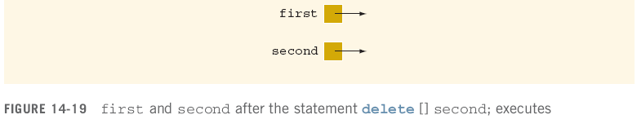
Shallow versus Deep Copy and Pointers (continued)
Shallow copy: two or more pointers of the same type point to the same memory
They point to the same data

Slide 38
Shallow versus Deep Copy and Pointers (continued)
Deep copy: two or more pointers have their own data

Slide 39

Classes and Pointers: Some Peculiarities

Slide 40
Destructor
If objectOne goes out of scope, the member variables of objectOne are destroyed
The memory space of the dynamic array would stay marked as allocated, even though it cannot be accessed

Slide 41
Destructor (continued)
Solution:
Put the necessary code in the destructor to ensure that when objectOne goes out of scope, the memory of the array is deallocated

Slide 42
Assignment Operator

Slide 43
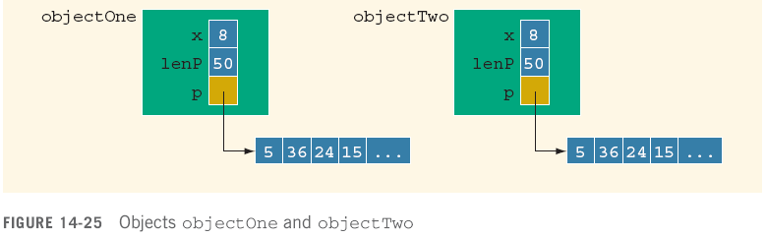
Assignment Operator (continued)
If objectTwo.p deallocates memory space to which it points, objectOne.p becomes invalid
Solution: extend definition of the assignment operator to avoid shallow copying of data

Slide 44
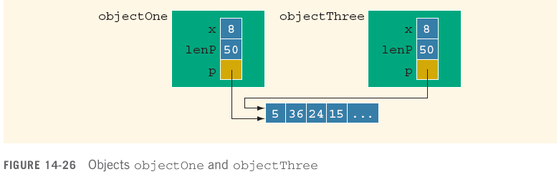
Copy Constructor
This initialization is called the default member-wise initialization
Initialization due to the constructor, called the copy constructor (provided by the compiler)

Slide 45
Copy Constructor (continued)
Default initialization leads to shallow copying of data
Similar problem occurs when passing objects by value:

Slide 46
Copy Constructor (continued)
Copy constructor automatically executes in three situations:
When an object is declared and initialized by using the value of another object
When, as a parameter, an object is passed by value
When the return value of a function is an object

Slide 47
Copy Constructor (continued)
Solution: properly define copy constructor

Slide 48
Copy Constructor (continued)
For classes with pointer member variables, three things are normally done:
Include the destructor in the class
Overload the assignment operator for the class
Include the copy constructor

Slide 49
Inheritance, Pointers, and Virtual Functions
You can pass an object of a derived class to a formal parameter of the base class type

Slide 51
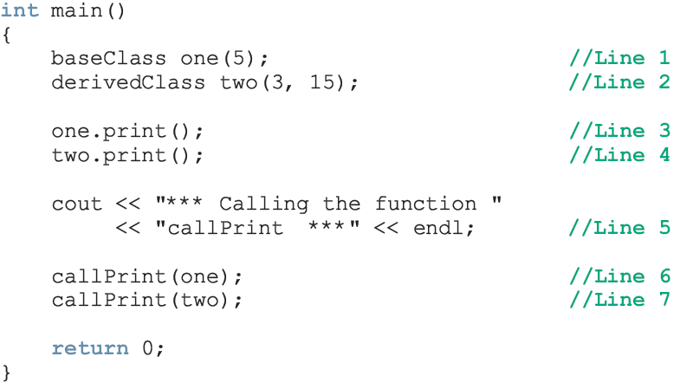
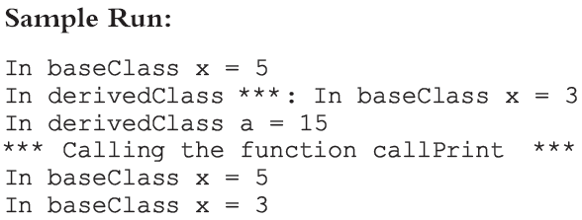

Slide 52
Inheritance, Pointers, and Virtual Functions (continued)
For both statements (Lines 6 and 7), member function print of baseClass was executed
Because the binding of print, in the body of callPrint, occurred at compile time
Compile-time binding: the necessary code to call a specific function is generated by the compiler
Also known as static binding

Slide 53
Inheritance, Pointers, and Virtual Functions (continued)
How can we avoid this problem?
Virtual functions (reserved word virtual)
Virtual function: binding occurs at program execution time, not at compile time
This kind of binding is called run-time binding
Run-time binding: compiler does not generate code to call a specific function; it generates information to enable run-time system to generate specific code for the function call
Also known as dynamic binding

Slide 54
Inheritance, Pointers, and Virtual Functions (continued)

Slide 55
Classes and Virtual Destructors
Classes with pointer member variables should have the destructor
Destructor can be designed to deallocate storage for dynamic objects
If a derived class object is passed to a formal parameter of the base class type, destructor of the base class executes
Regardless of whether object is passed by reference or by value
Solution: use a virtual destructor (base class)

Slide 56
Classes and Virtual Destructors (continued)
The virtual destructor of a base class automatically makes the destructor of a derived class virtual
After executing the destructor of the derived class, the destructor of the base class executes
If a base class contains virtual functions, make the destructor of the base class virtual

Slide 57
Abstract Classes and Pure Virtual Functions
Through inheritance, we can derive new classes without designing them from scratch
Derived classes inherit existing members of base class, can add their own members, and also redefine or override public and protected member functions
Base class can contain functions that you would want each derived class to implement
Base class may contain functions that may not have meaningful definitions in the base class

Slide 58
Abstract Classes and Pure Virtual Functions (continued)
To make them pure virtual functions:

Slide 59
Abstract Classes and Pure Virtual Functions (continued)
Abstract class: contains one or more pure virtual functions
You cannot create objects of an abstract class

Slide 60
Abstract Classes and Pure Virtual Functions (continued)
If we derive rectangle from shape, and want to make it a nonabstract class:
We must provide the definitions of the pure virtual functions of its base class
Note that an abstract class can contain instance variables, constructors, and functions that are not pure virtual
The class must provide the definitions of constructor/functions that are not pure virtual

Slide 61
Address of Operator and Classes
& operator can create aliases to an object
Consider the following statements:
int x;
int &y = x;
x and y refer to the same memory location
y is like a constant pointer variable
y = 25; sets the value of y (and of x) to 25
x = 2 * x + 30; updates the value of x and hence of y

Slide 62
Address of Operator and Classes (continued)
The address of operator can also be used to return the address of a private member variable of a class
However, if you are not careful, this operation can result in serious errors in the program

Slide 63
Summary
Pointer variables contain the addresses of other variables as their values
Declare a pointer variable with an asterisk, *, between the data type and the variable
& is called the address of operator
Returns the address of its operand
Unary operator * is the dereferencing operator
Member access operator, ->, accesses the object component pointed to by a pointer

Slide 64
Summary (continued)
Dynamic variable: created during execution
Created using new, deallocated using delete
Shallow copy: two or more pointers of the same type point to the same memory
Deep copy: two or more pointers of the same type have their own copies of the data
Can pass an object of a derived class to a formal parameter of the base class type
Binding of virtual functions occurs at execution time (dynamic or run-time binding)

